Slide 1
Machine Learning Algorithms on Datasets:
Dimensionality Reduction
Dr. Memo Ergezer
Bryon Kucharski
HackWITus 2017
Boston, MA

Slide 2
Outline
New class: Embedded Machine Learning
Machine learning
PCA vs LDA
Datasets
Summary

Slide 3
Setup
Slides: https://goo.gl/X3qwVe
Workshop code in Matlab / Octave
Can run Octave online for free:
http://octave-online.net/#
Download scripts from
https://github.com/memoatwit/hackwitus2017
Octave workspace: https://goo.gl/GSufFN

Slide 4
EML Course
Coming summer of 2018* *or so I hope
Will focus on running AI algorithms on embedded systems
Background Linear algebra, Statistics, Probability, Python
Embedded Systems: real-time processing vs offline processing
Machine learning: Statistical and Deep learning

Slide 5


Octave
Free under GNU Public License
Compatible with MATLAB
Interpreted programming language
Great for Matrix operations
Numpy
Differences
Matrices stored as column-major order (Fortran)
1-based indexing
No passing by reference
Notes:
How many familiar with Matlab? Python?
Assure that we will do a quick intro

Slide 6
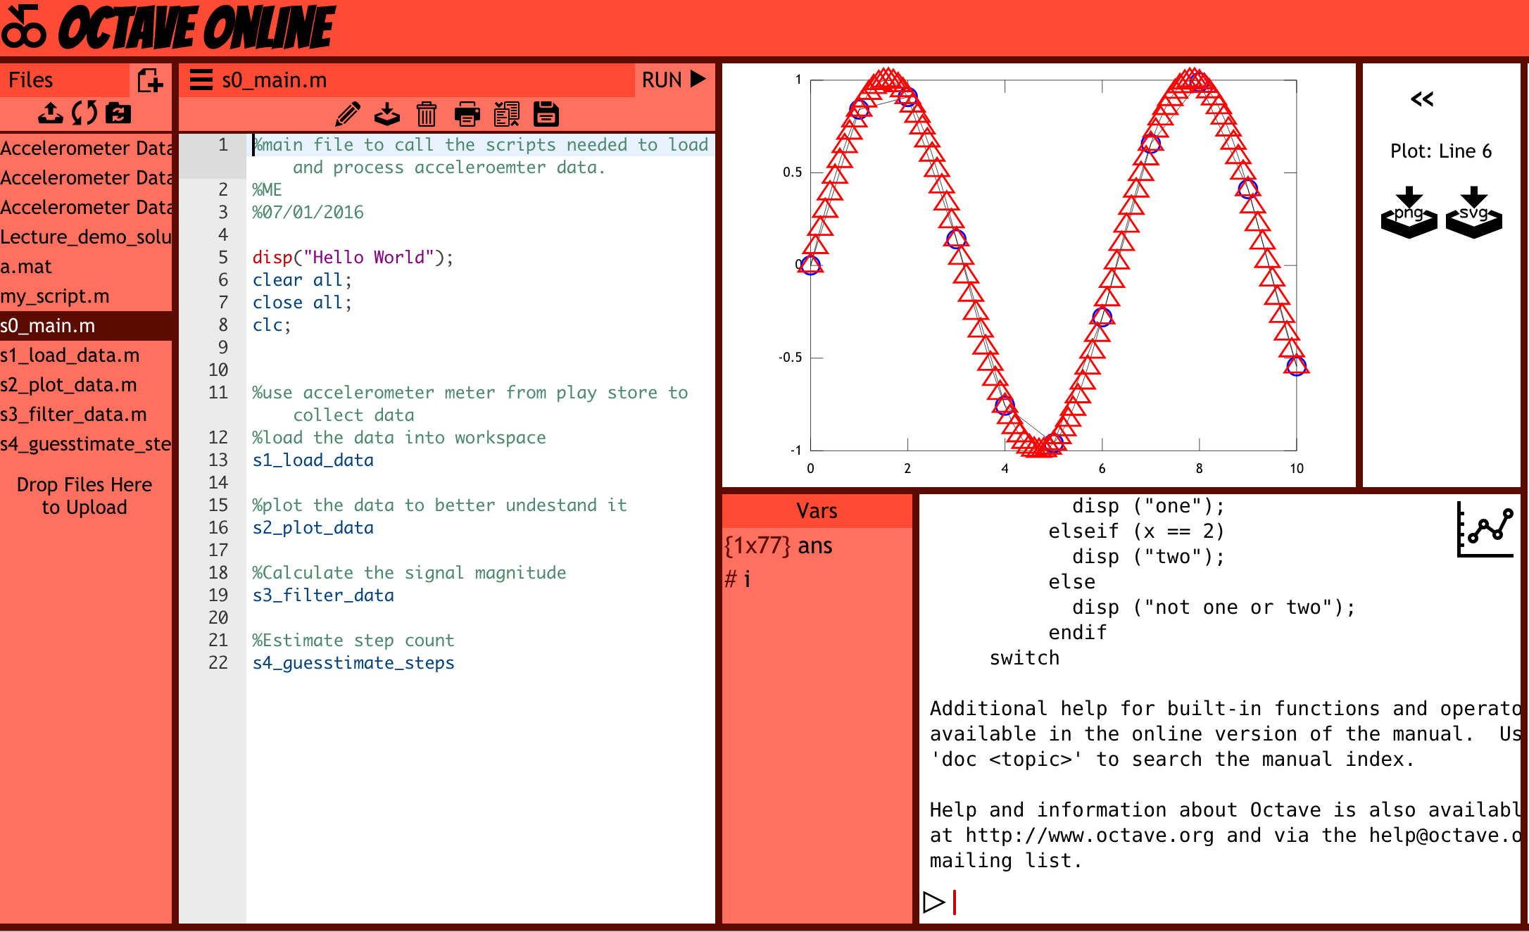
Octave Online

Slide 7
Octave Introduction
Download-free 10 sec execution time at:
http://octave-online.net/
Plot
Help plot
plot(0:10,sin(pi*0:10))
For
for i = 1:10; disp("i: ",num2str(i)); end
Average
x=1:10; mean(x)
Notes:
Q?

Slide 8
Embedded: Smartphone Dataset
30 volunteers wearing a smartphone (Samsung Galaxy S II) on the waist.
Six activities: WALKING, WALKING_UPSTAIRS, WALKING_DOWNSTAIRS, SITTING, STANDING, LAYING
3-axial linear acceleration and 3-axial angular velocity at a constant rate of 50Hz
Randomly partitioned into two sets: 70% training data and 30% test data.

Slide 9
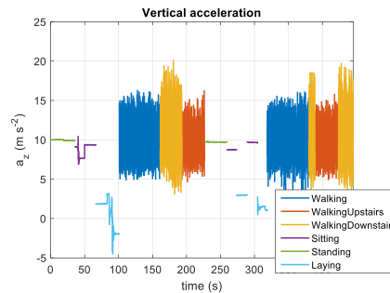

Slide 10
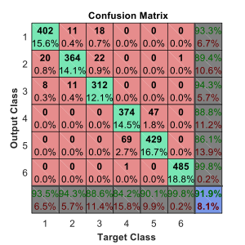
Smartphone Dataset
Train a classifier using 66 features and 6 classes
Mean, RMS and spectral features
Neural Nets
18 nodes in a hidden layer
Creates training and validation data sets

Slide 11
Machine Learning
All ML is stat / probability based design
Linear algebra for implementation
Analyze data to make a prediction
Classification, clustering, regression, dimensionality reduction
(Un)Supervised learning: Input and output data is (un)labeled

Slide 12
Machine Learning
Classification: Output estimate is discrete
Email: spam or not,
Photo: Cat or dog,
Photo: Cat, dog, me, mom, dad, …
Clustering: Output estimate is discrete, but # of classes in unknown
Unsupervised learning
Email: Spam, promotion, social, family, work, school, ?

Slide 13
Machine Learning
Regression: Output estimate is continuous
Estimate house sale price Based on zip code, sq ft, # of room/bathrooms
Estimate salary Based on age, gender, education, zip code, …
Stock portfolio performance ROE, S/P, B/P, Market value, Return rate, ...

Slide 14
Machine Learning
Dimensionality Reduction: No prediction.
Reduce the number of features
Estimate salary based on population data Based on age, gender, education, zip code, GPA, height, weight, Facebook followers, MySpace followers, number of pets, hours watching Netflix, race, ...
Detect faults while manufacturing a robot/car:
Time spent per station, 20 sensors collecting thousands of data points

Slide 15
Machine Learning
Dimensionality Reduction: No prediction.
How much does each feature contribute?
Do I need 1000 features?
Do I need 100 features?
Can I improve classification, regression, etc. via reducing features?

Slide 16
Today
Statistical data analysis
Supervised learning
Dimensionality reduction

Slide 17
Dataset: Breast cancer diagnosis
Images from fine needle biopsies of breast masses
569 patients: 357 benign, 212 malignant
30 features
"Decision Tree Construction Via Linear Programming"
Octave: lda_wdbc_data.m
https://archive.ics.uci.edu/ml/datasets/Breast+Cancer+Wisconsin+%28Diagnostic%29

Slide 18
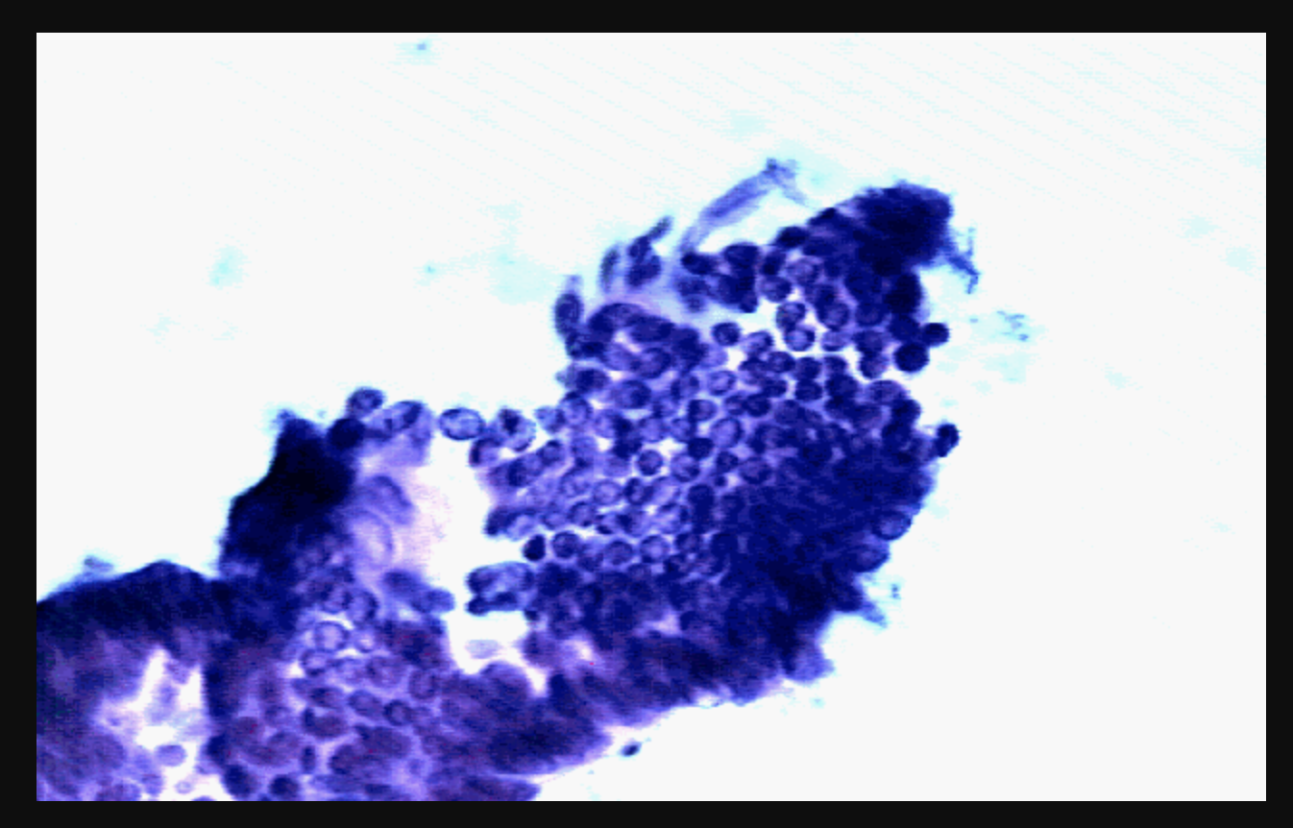
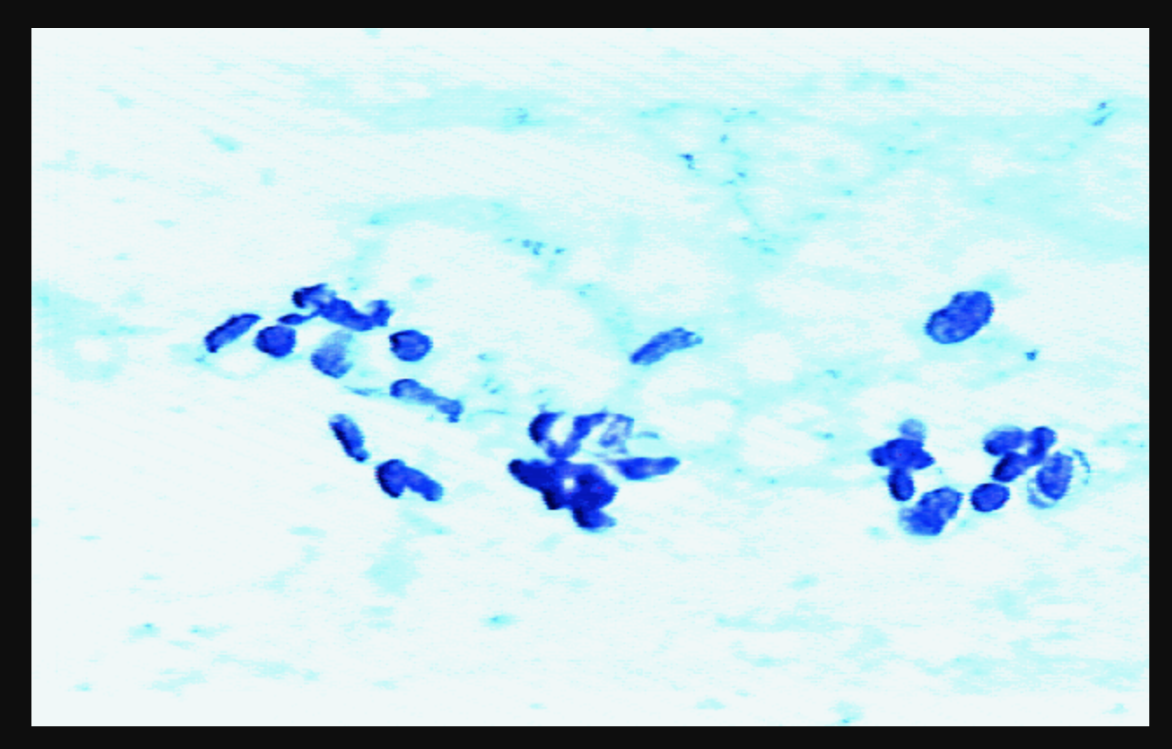
Breast cancer diagnosis
Bening
Bening

Slide 19
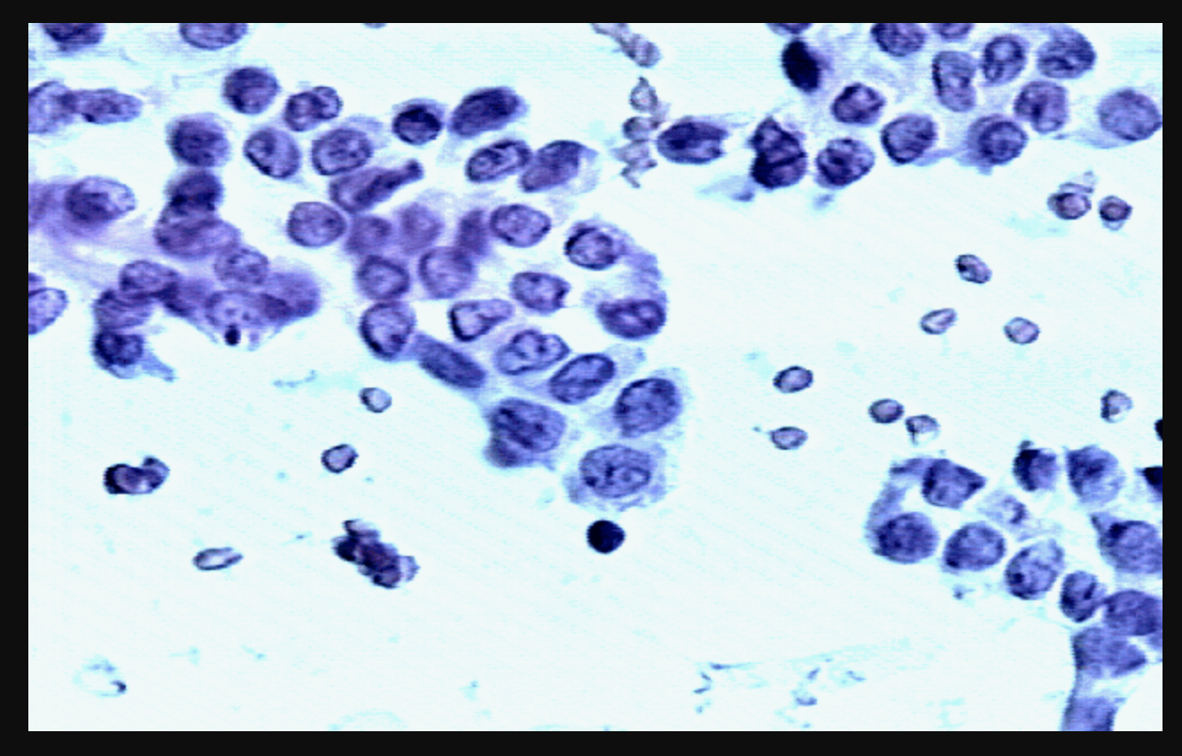
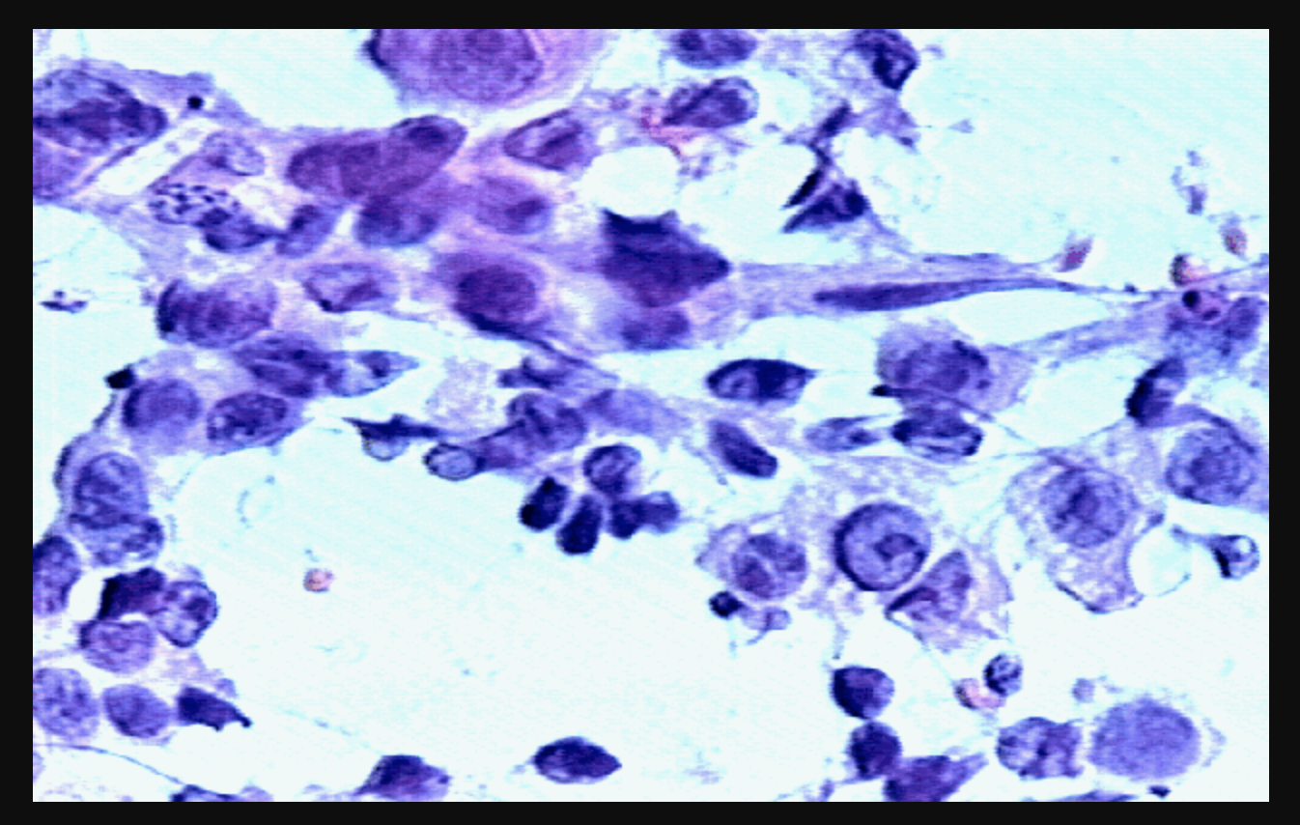
Breast cancer diagnosis
Malignant
Malignant

Slide 20
Data
Cell nucleus: a) radius (mean of distances from center to points on the perimeter) b) texture (standard deviation of gray-scale values) c) perimeter d) area e) smoothness (local variation in radius lengths) f) compactness (perimeter^2 / area - 1.0) g) concavity (severity of concave portions of the contour) h) concave points (number of concave portions of the contour) i) symmetry j) fractal dimension ("coastline approximation" - 1)

Slide 21
PCA
Principal Component Analysis (PCA)
Linear transformation (matrix multiplication):
X_projected = X W_pca
Max variance
Find the eigenvalues/vectors of the covariance matrix
Select C eigenvectors to max the variance between classes
~5 lines of code

Slide 22
Dimensions
Number of samples: 569
Number of classes: 2
Number of features: 30
Reduced number of features = number of classes - 1 = 1
X = [569x30]
W_pca = [30x1]
X_projected = X W_pca = [569x30] [30x1] = 569x1

Slide 23
LDA
Linear Discriminant Analysis (LDA)
Linear transformation (matrix multiplication):
Xp = X * Wlda
Max scatter between classes while min it within the class
Find variances between classes and within a class
Find the eigenvalues/vectors of the (scatter within class / between classes)
Select C eigenvectors to max the variance between classes

Slide 24
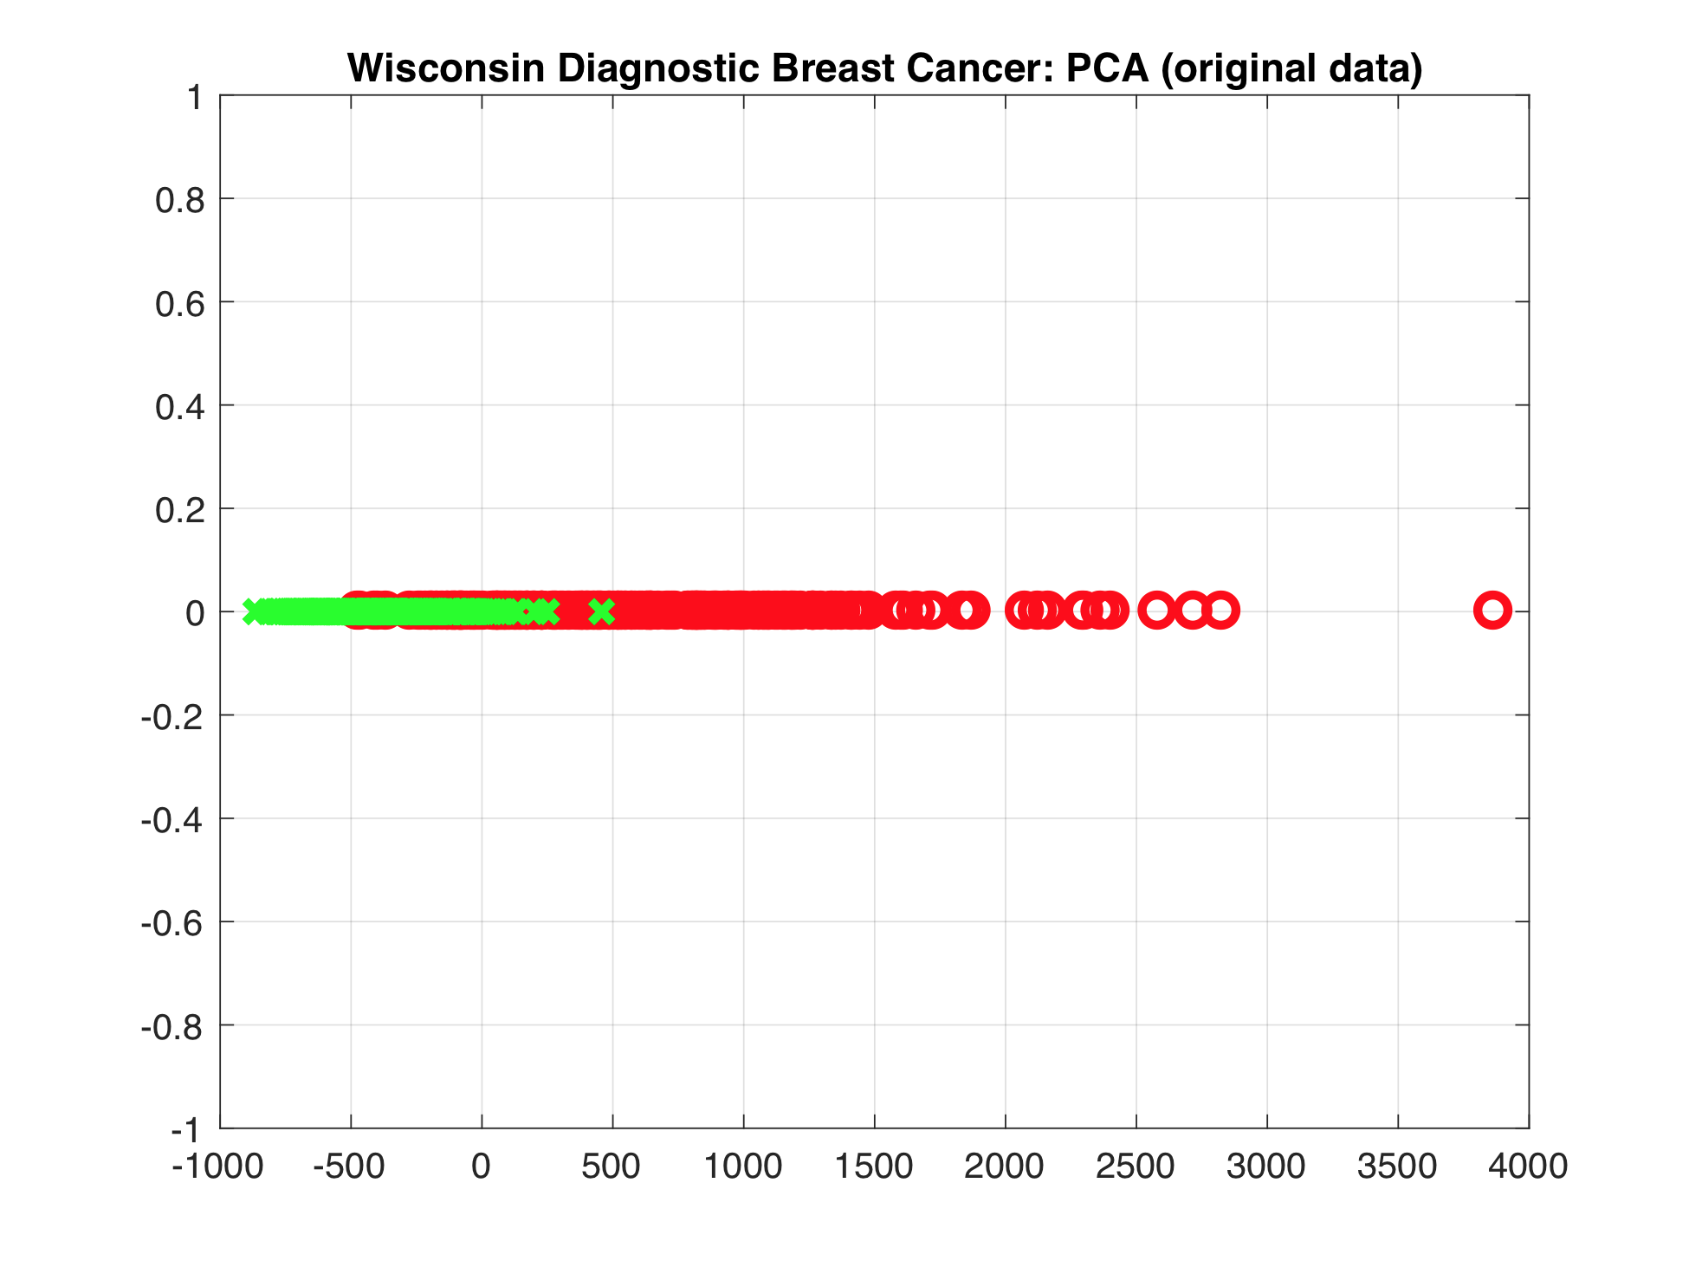

Slide 25
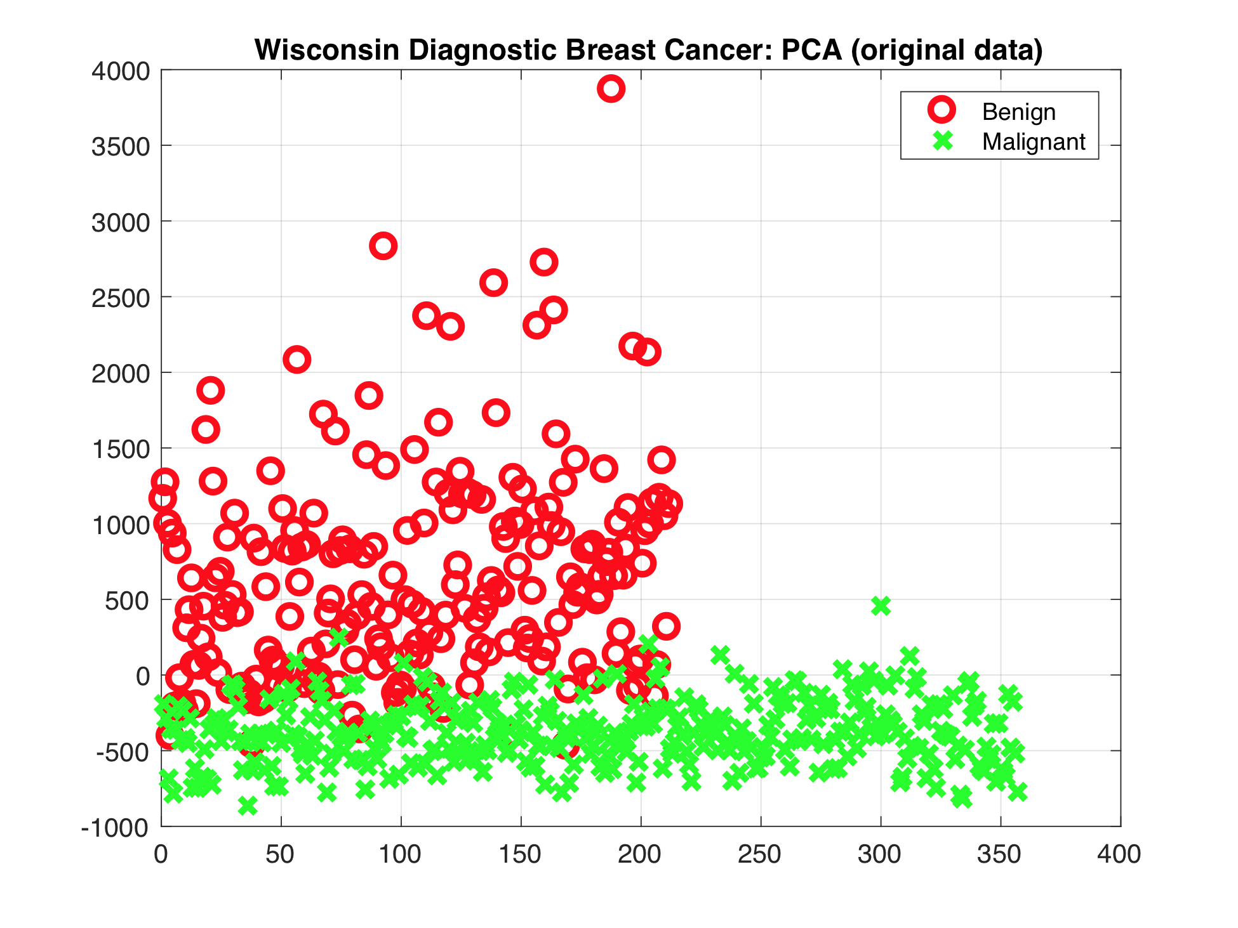

Slide 26
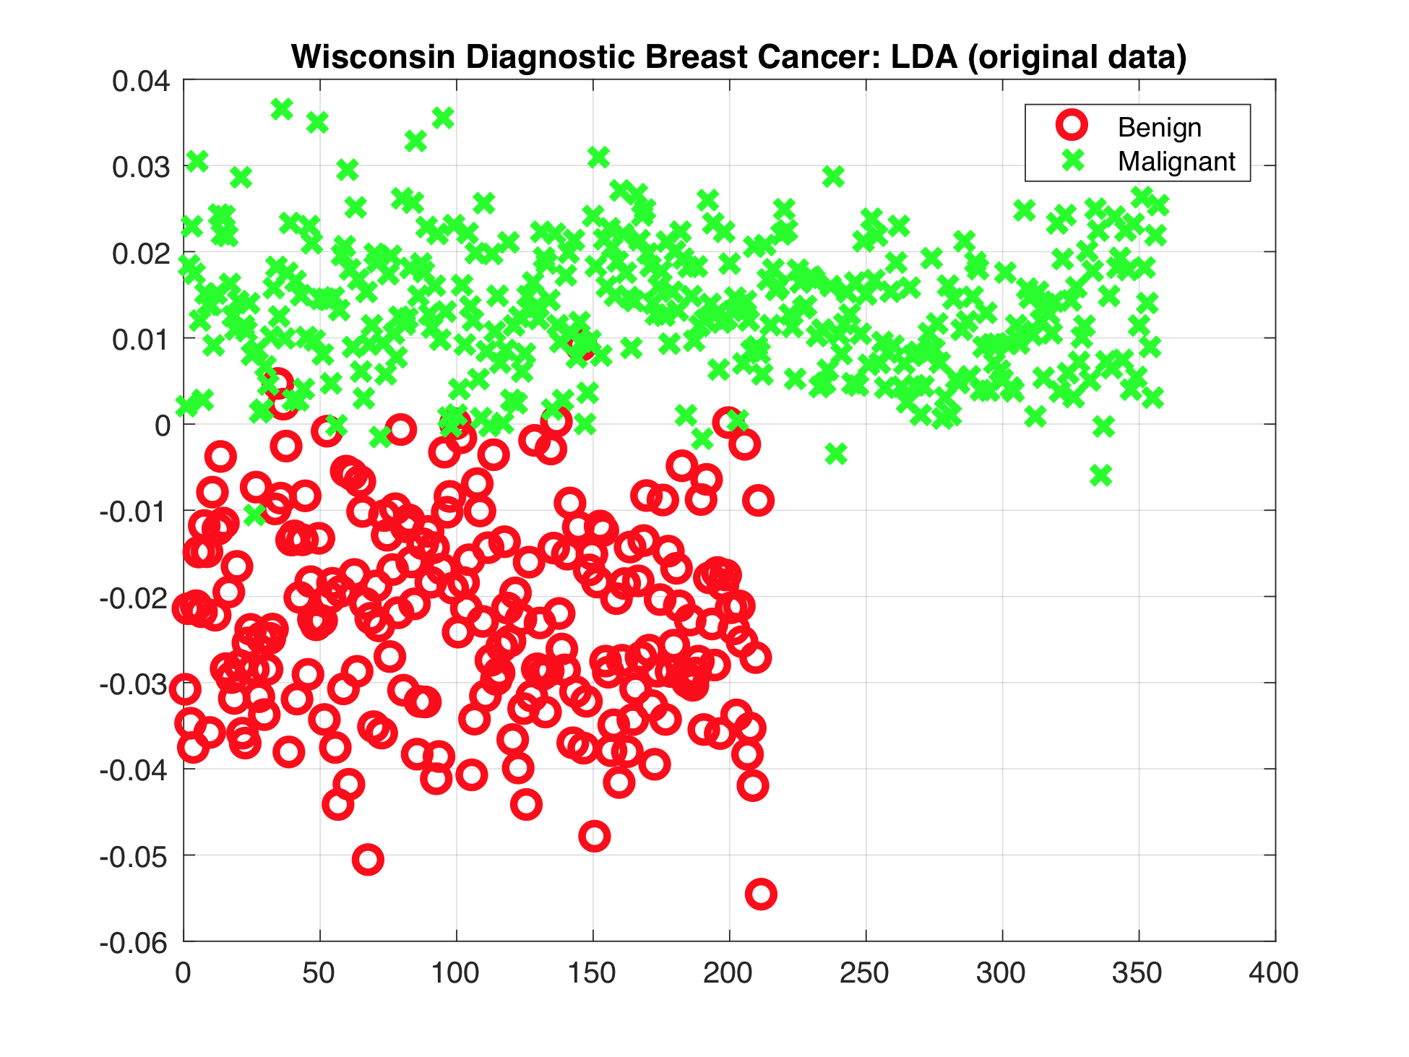

Slide 27
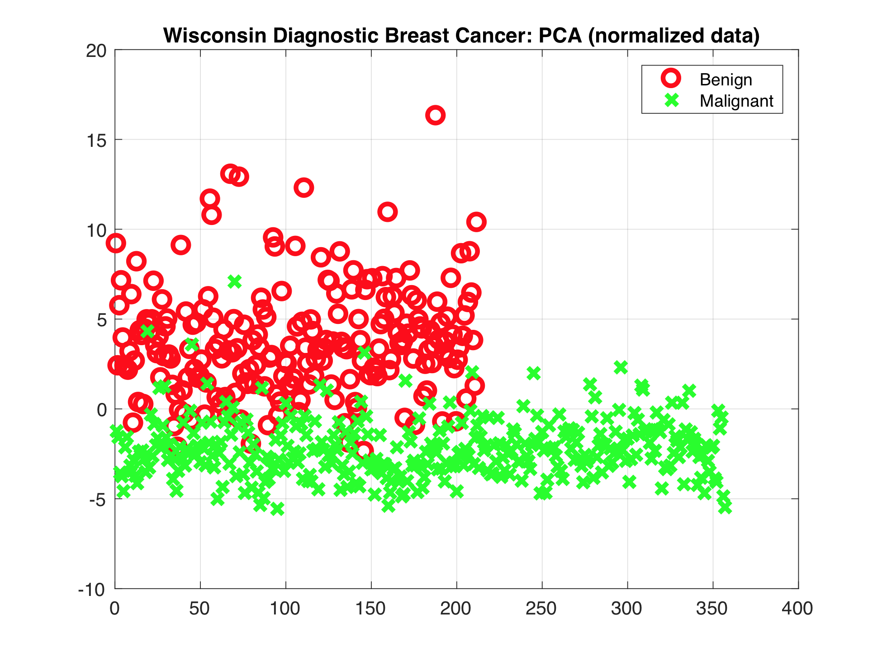

Slide 28
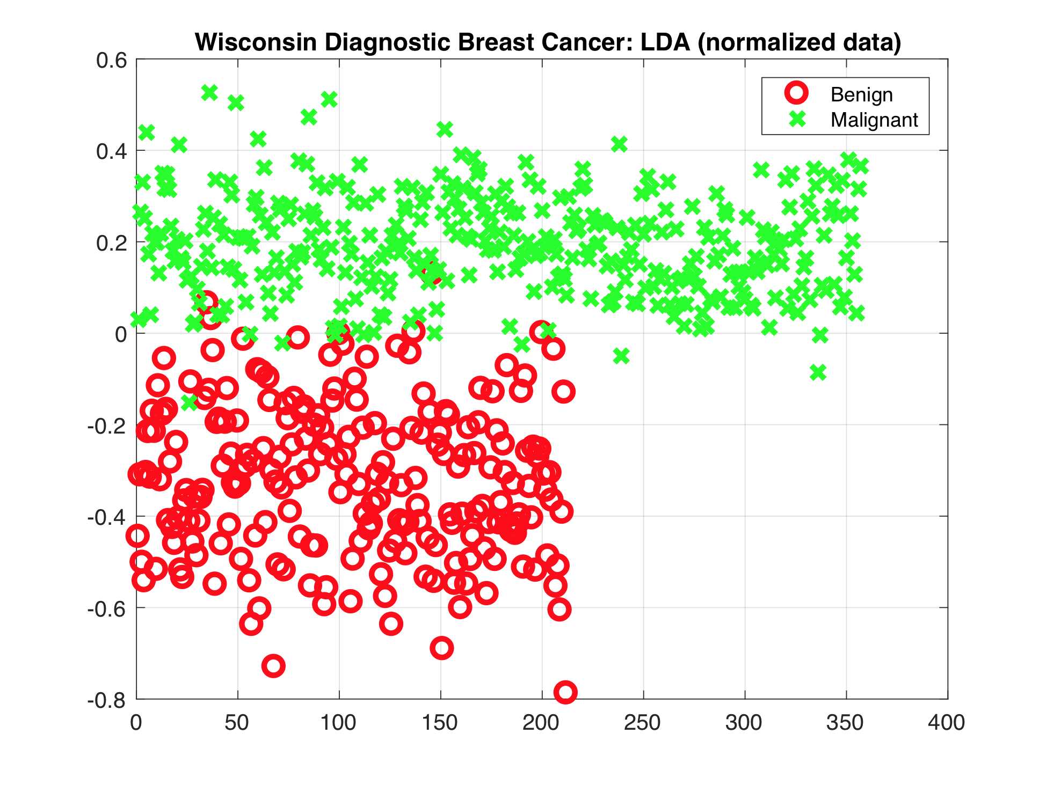

Slide 29

Wine Dataset
“... chemical analysis of wines grown in the same region in Italy but derived from three different cultivars”
178 instances
with 13 attributes
from 3 classes
Octave: lda_wine_data.m

Slide 30
Wine Dataset
1) Alcohol
2) Malic acid
3) Ash
4) Alcalinity of ash
5) Magnesium
6) Total phenols
7) Flavanoids
8) Nonflavanoid phenols
9) Proanthocyanins
10)Color intensity
11)Hue
12)OD280/OD315 of diluted wines
13)Proline

Slide 31
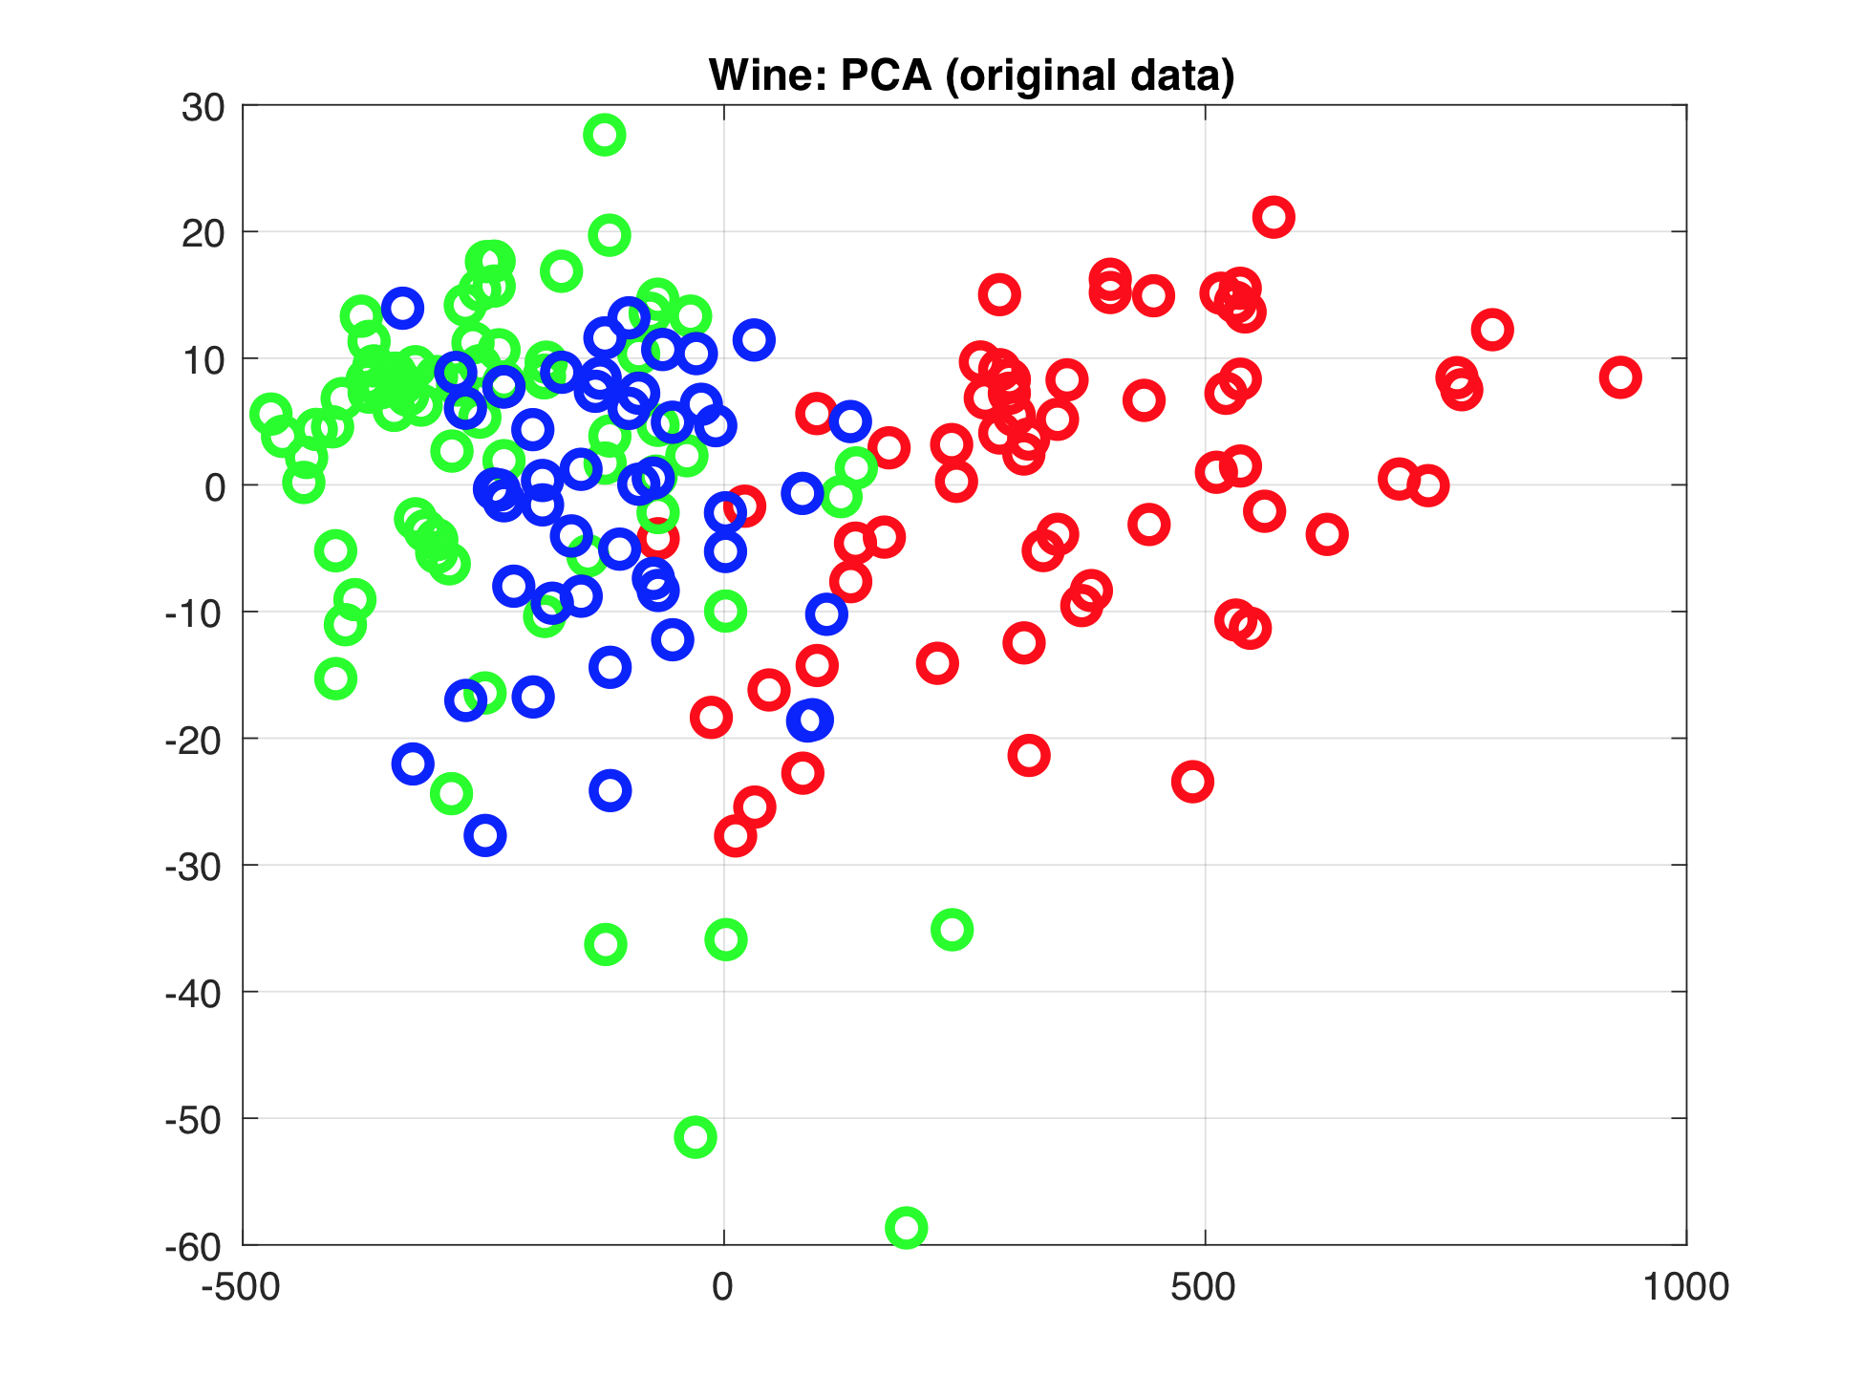

Slide 32
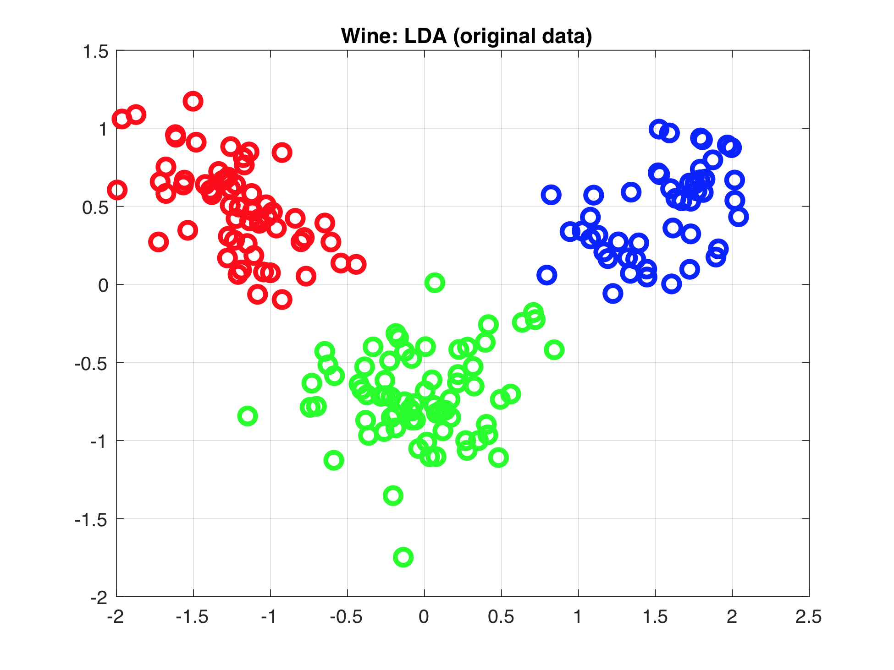

Slide 33
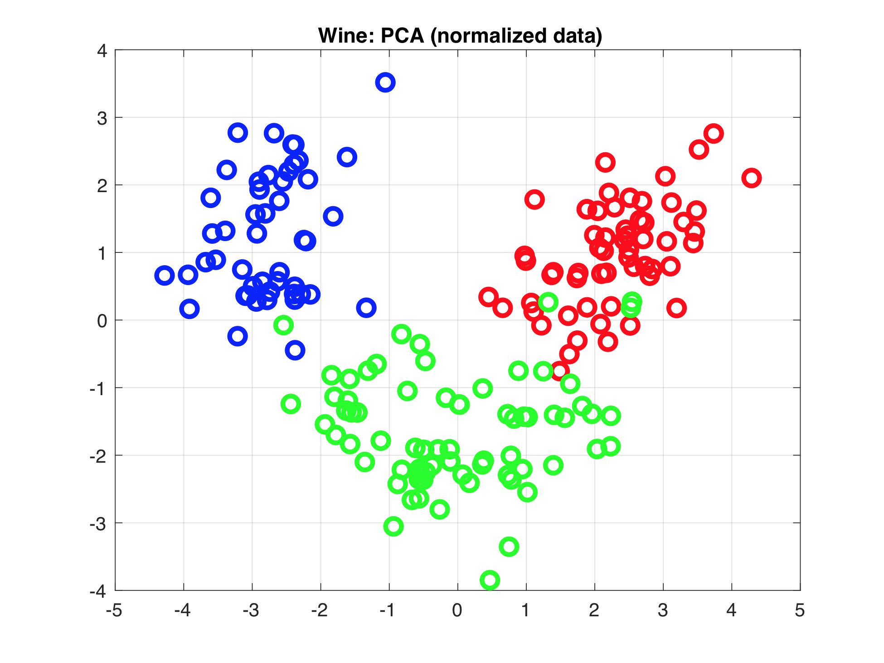

Slide 34
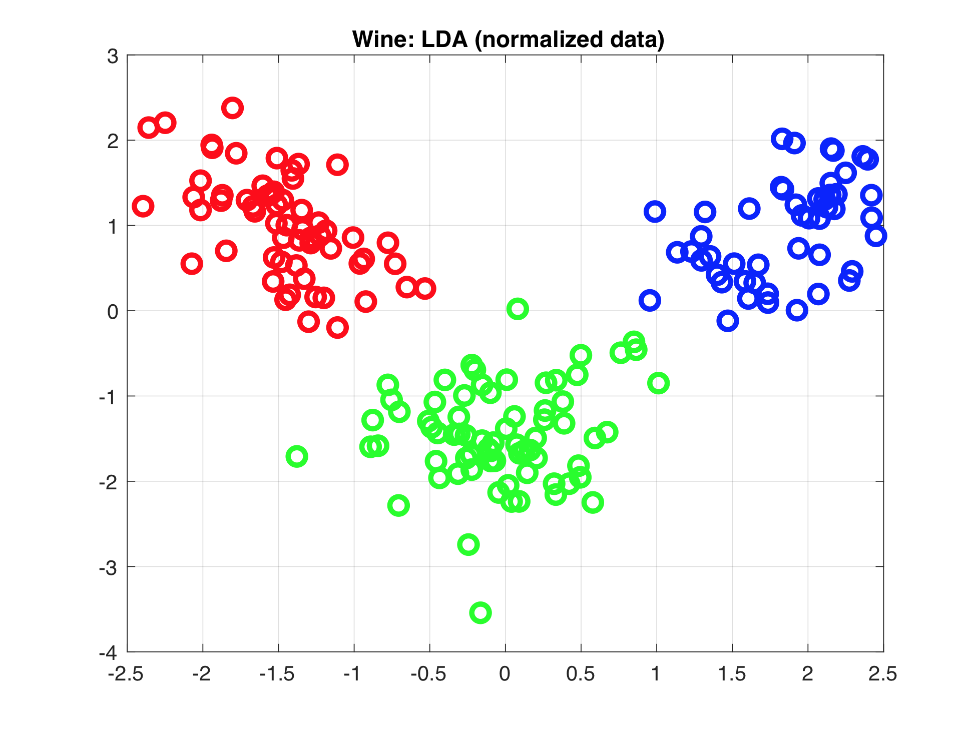

Slide 35
Other info
First eigenvector covers 0.36199% of variance
We need a min of 8 features to cover 90% of variance
First 8 feature(s) are:
13 12 11 10 9 8 7 6

Slide 36
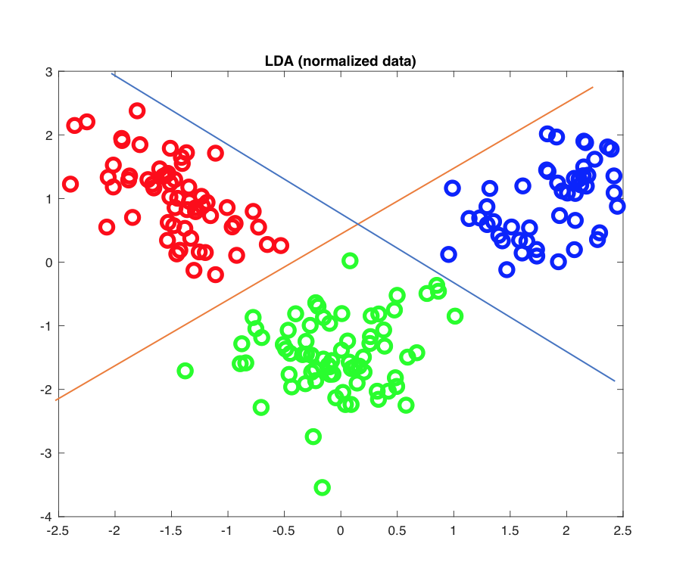

Slide 37
Deep Learning: Cats vs Dogs
25,000 images
Each image different size
A Pixel 2 image is 12.2 MP (3,024 × 4,032)
Cats vs Dogs
Famous Kaggle competition
DNN cannot be trained on my laptop
AWS/GCloud to the rescue

Slide 38
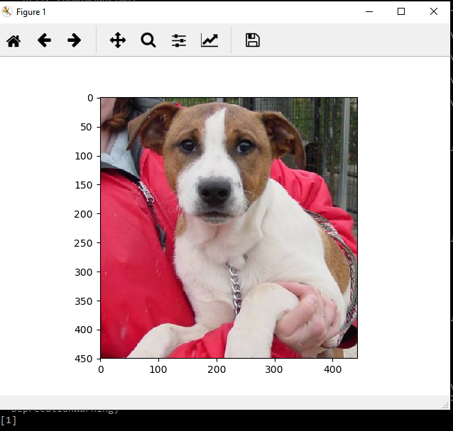

Slide 39
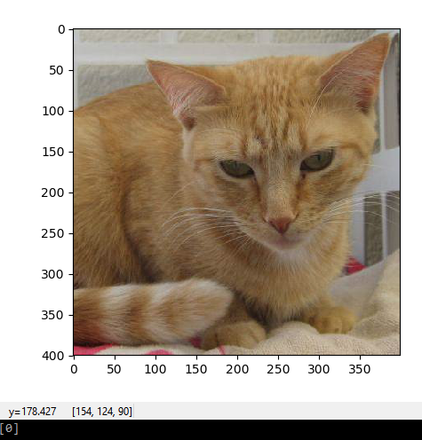

Slide 40
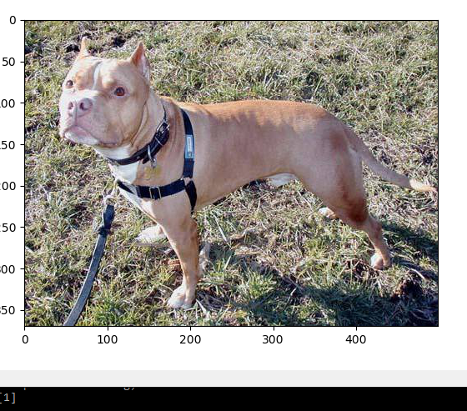

Slide 41
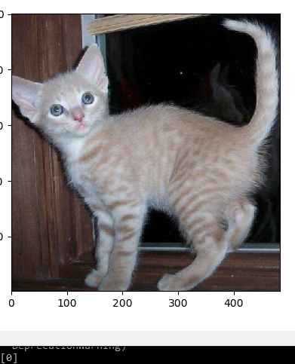

Slide 42
Conclusion
ML/AI field is vast
Do not use API’s given to you by strangers It might be faster to create your own tools than debug others’
Scale your data!
Understand your data and simplify it when you can

Slide 43

Thanks!

Slide 44

Questions?

Slide 45
References
https://github.com/memoatwit/hackwitus2017
Breast cancer: https://goo.gl/C1U6hV
Wine: https://archive.ics.uci.edu/ml/datasets/wine
Smartphone-Based Recognition of Human Activities and Postural Transitions Data Set: https://goo.gl/5xdtuD, Matlab: https://goo.gl/3AmJ84

Slide 46
References: LDA, PCA
http://www.bytefish.de/blog/pca_lda_with_gnu_octave/
http://research.cs.tamu.edu/prism/lectures/pr/pr_l10.pdf
https://lazyprogrammer.me/tutorial-principal-components-analysis-pca/

